Slide 1
RASPBERRY PI Remote GPIO
day - 6

Slide 2


Button : installing wiringPi
$ gpio –v // check if installed
Check if its working
$ gpio –g mode 26 out
$ gpio –g read 26
$ gpio –g write 26 1
If not working:
$ sudo apt-get purge wiringpi
$ hash –r
$ cd
$ git clone git://git.drogon.net/wiringPi
$ cd ~/wiringPi
$ git pull origin
$ cd ~/wiringPi
$ ./build
// check again if its working

Slide 3
Privileges to access www-data
$ sudo visudo
# See sudoers(5) for more information on "#include" directives:
#includedir /etc/sudoers.d
pi ALL=(ALL) NOPASSWD: ALL
www-data ALL=(ALL) NOPASSWD: ALL

Slide 4
www/leds/gpio/index.php
<html>
<head>
<!--index.php-->
</head>
<body>
<!—GPIO26-->
<form action="" method="post">
GPIO 26 &nbsp;
<input type="submit" name="on_26" value="on">
<input type="submit" name="off_26" value="off">
<input type="submit" name="blink_26" value="blink">
</body>
</html>

Slide 5
www/leds/gpio/index.php (cont.)
<?php
if ($_POST[on_26]) {
$a- exec("gpio -g mode 26 out");
$a- exec("gpio -g write 26 1");
echo $a;
echo "led26 is on";
}
if ($_POST[off_26]) {
$a- exec("gpio -g mode 26 out");
$a- exec("gpio -g write 26 0");
echo $a;
echo "led26 is off";
}
if ($_POST[blink_26]) {
$a- exec("gpio -g mode 26 out");
$var = 5;
while ($var--){
$a- exec("gpio -g write 26 1");
usleep(500000);
$a- exec("gpio -g write 26 0");
usleep(500000);
}
echo "led26 blinky complete";
}
?>

Slide 6
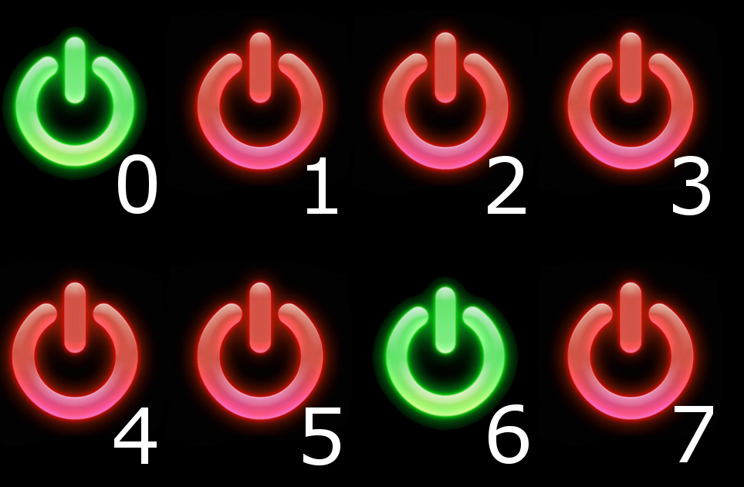
Button: Layout

Slide 7
Button: Downloading Images
$ cd
$ wget https://cdn.instructables.com/ORIG/FUQ/ZHUM/IBEWRSX4/FUQZHUMIBEWRSX4.zip
$ unzip FUQZHUMIBEWRSX4.zip
$ cd Web\ 2.0/
$ sudo mv data /var/www/leds/gpio_img/
$ cd /var/www/leds/gpio_img/
// lets start configuring gpio-button-leds-webpage

Slide 8
Button : index.php
<!DOCTYPE html>
<!--TheFreeElectron 2015, http://www.instructables.com/member/TheFreeElectron/ -->
<html>
<head>
<meta charset="utf-8" />
<title>Raspberry Pi Gpio</title>
</head>
<body style="background-color: black;">
<!-- On/Off button's picture -->
<?php
$gpio_num_map = array(26,19,13,6,5,21,20,16);
$val_array = array(0,0,0,0,0,0,0,0);
//this php script generate the first page in function of the file
for ( $i= 0; $i<8; $i++) {
//set the pin's mode to output and read them
system("gpio -g mode ".$gpio_num_map[$i]." out");
exec ("gpio -g read ".$gpio_num_map[$i], $val_array[$i], $return );
}

Slide 9
Button : index.php (cont.)
//for loop to read the value
$i =0;
for ($i = 0; $i < 8; $i++) {
//if off
if ($val_array[$i][0] == 0 ) {
echo ("<img id='button_".$i."' src='data/img/red/red_".$i.".jpg' onclick='change_pin (".$i.");'/>");
}
//if on
if ($val_array[$i][0] == 1 ) {
echo ("<img id='button_".$i."' src='data/img/green/green_".$i.".jpg' onclick='change_pin (".$i.");'/>");
}
}
?>
<!-- javascript -->
<script src="script.js"></script>
</body>
</html>

Slide 10
Button: gpio.php
<?php
//TheFreeElectron 2015, http://www.instructables.com/member/TheFreeElectron/
//This page is requested by the JavaScript, it updates the pin's status and then print it
//Getting and using values
if (isset ( $_GET["pic"] )) {
$pic = strip_tags ($_GET["pic"]);
$gpio_num_map = array(26,19,13,6,5,21,20,16);
//test if value is a number
if ( (is_numeric($pic)) && ($pic <= 7) && ($pic >= 0) ) {
//set the gpio's mode to output
system("gpio -g mode ".$gpio_num_map[$pic]." out");
//reading pin's status
exec ("gpio -g read ".$gpio_num_map[$pic], $status, $return );

Slide 11
Button: gpio.php (cont.)
//set the gpio to high/low
if ($status[0] == "0" ) { $status[0] = "1"; }
else if ($status[0] == "1" ) { $status[0] = "0"; }
system("gpio -g write ".$gpio_num_map[$pic]." ".$status[0] );
//reading pin's status
exec ("gpio -g read ".$gpio_num_map[$pic], $status, $return );
//print it to the client on the response
echo($status[0]);
}
else { echo ("fail"); }
} //print fail if cannot use values
else { echo ("fail"); }
?>

Slide 12
Button: script.js
//JavaScript, uses pictures as buttons, sends and receives values to/from the Rpi
//These are all the buttons
var button_0 = document.getElementById("button_0");
var button_1 = document.getElementById("button_1");
var button_2 = document.getElementById("button_2");
var button_3 = document.getElementById("button_3");
var button_4 = document.getElementById("button_4");
var button_5 = document.getElementById("button_5");
var button_6 = document.getElementById("button_6");
var button_7 = document.getElementById("button_7");

Slide 13
Button: script.js (cont.)
//Create an array for easy access later
var Buttons = [ button_0, button_1, button_2, button_3, button_4, button_5, button_6, button_7];
//This function is asking for gpio.php, receiving datas and updating the index.php pictures
function change_pin ( pic ) {
var data = 0;
//send the pic number to gpio.php for changes
//this is the http request
var request = new XMLHttpRequest();
request.open( "GET" , "gpio.php?pic=" + pic, true);
request.send(null);
//receiving informations

Slide 14
Button: script.js (cont.)
request.onreadystatechange = function () {
if (request.readyState == 4 && request.status == 200) {
data = request.responseText;
//update the index pic
if ( data == 0 ){
Buttons[pic].src = "data/img/red/red_"+pic+".jpg";
}
else if ( data == 1 ) {
Buttons[pic].src = "data/img/green/green_"+pic+".jpg";
}
else if ( !(data.localeCompare("fail"))) {
alert ("Something went wrong!" );
return ("fail");
}

Slide 15
Button: script.js (cont.)
else {
alert ("Something went wrong!" );
return ("fail");
}
}
//test if fail
else if (request.readyState == 4 && request.status == 500) {
alert ("server error");
return ("fail");
}
//else
else if (request.readyState == 4 && request.status != 200 && request.status != 500 ) {
alert ("Something went wrong!");
return ("fail"); }
}
return 0;
}

